Slide 1
Budget and Budgetary Control

Slide 2
Budget
The term ‘Budget’ appears to have been derived from the French word ‘baguette’ which means ‘little bag' , or a container of documents and accounts.
A budget is an accounting plan. It is a formal plan of action expressed in monetary terms.

Slide 3
Definition
According to CIMA (Chartered Institute of Management Accountants) UK, a budget is “A plan quantified in monetary terms prepared and approved prior to a defined period of time, usually showing planned income to be generated and, expenditure to be incurred during the period and the capital to be employed to attain a given objective.”

Slide 4
Strategic, Budgetary and operational planning
Strategic - Long term action plans to attain organizational objectives.
Budgetary planning – Short to medium term plan.
Operational – Day to day planning process.

Slide 5
Budgetary control
“Budgetary control is the establishment of budgets relating to the responsibilities of executives of a policy and the continuous comparison of the actual with the budgeted results, either to secure by individual action, the objective of the policy or to provide a basis for its revision.”

Slide 6
Objectives
Planning
Co‐ordination: Budgeting plays a significant role in establishing and maintaining coordination. Budgeting assists managers in coordinating their efforts so that problems of the business are solved in harmony with the objectives of its divisions.
Motivation: Budget is always considered a useful tool for encouraging managers to complete things in line with the business objectives.
Communication: A budget serves as a means of Communicating information within a firm.
Control: Control is essential to make sure that plans and objectives laid down in the budget are being achieved

Slide 7
Advantages
This system provides basic policies for initiatives.
It enables the management to perform business in the most professional manner because budgets are prepared to get the optimum use of resources and the objectives framed.
It ensures team work and thus encourages the spirit of support and mutual understanding among the staff.
It increases production efficiency, eliminates waste and controls the costs.
It shows to the management where action is needed to remedy a position.
Budgeting also aids in obtaining bank credit.

Slide 8
Preparation
Differs from organization to organization
Co- ordination : Budget committee is formed which includes all the departmental heads together to solve a common problem.
One budget cannot be complete without reference to several others.

Slide 9
Budget manual
A budget manual is a collection of documents that contains key information for those involved in the planning process. It includes:
Introductory explanation
Organizational chart
Time table

Slide 10
Principle budget factor
The principal budget factor is the factor that limits the activities of functional budgets of the organization.
In general sales volume.
All budgets are interrelated.

Slide 11
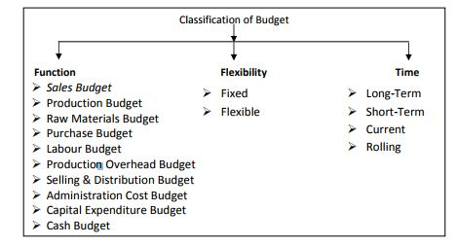
Classification

